Slide 1

CounterStike
Item Market Database
Ryan Munger

Slide 2
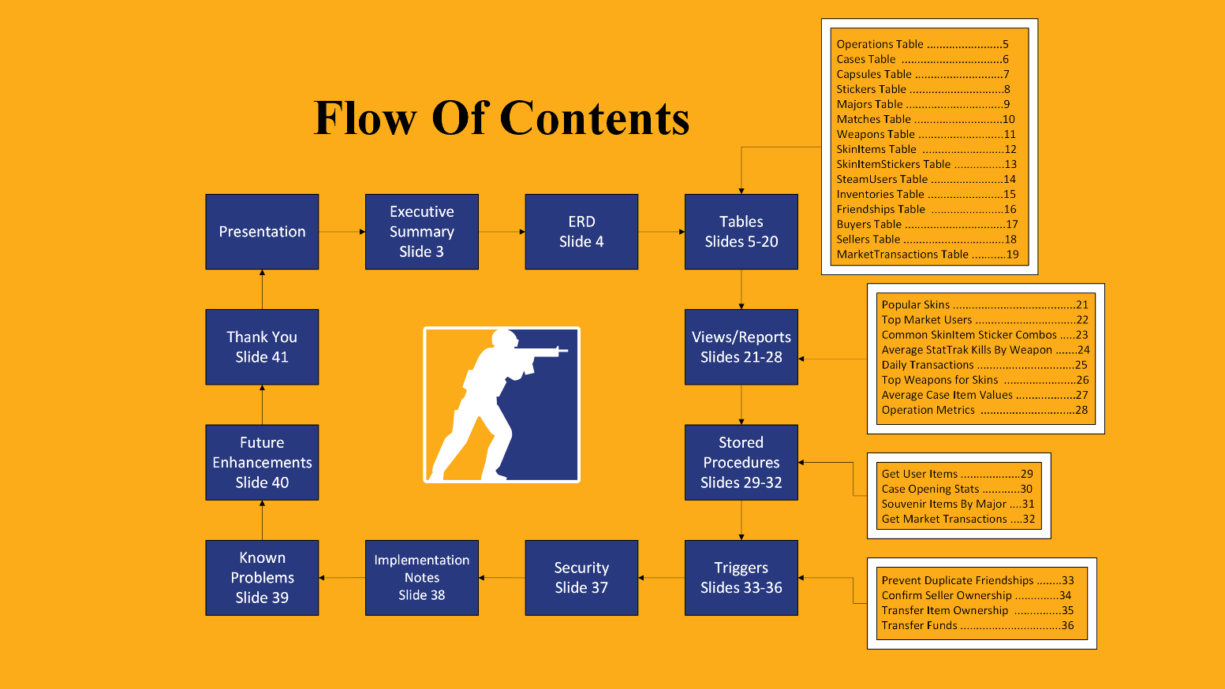
Table of Contents

Slide 3
Executive Summary
This document provides an overview of the database schema designed for a CounterStrike2 (CS2) item marketplace. The database captures the relationships between various entities within the CS ecosystem, including operations, cases, capsules, stickers, majors, matches, weapons, skin items, users, and market transactions. This schema aims to facilitate efficient storage and retrieval of data related to CS items, their attributes, and their trading history. This document contains the respective create statements and documentation for each table as well as useful reports (queries), view definitions, stored procedures, triggers, and security features.
Objectives
The primary objectives of this database are to:
Organize CS Item Data: Systematically structure data related to CS items (skins, stickers, etc.) and their characteristics.
Track Items: Record the origin and history of items, including the cases or capsules they were obtained from.
Manage Market Transactions: Store data on item sales, including buyer, seller, price, and timestamps.
Store User Information: Maintain data on Steam users, including their inventories and trading activity.
Support Major Tournament Data: Store information about CS Major tournaments, matches, and related skin items.
Enable Complex Queries: Facilitate complex queries for data analysis, reporting, and application development.
Ensure Data Integrity: Enforce data consistency and accuracy through constraints, data types, and relationships.

Slide 4
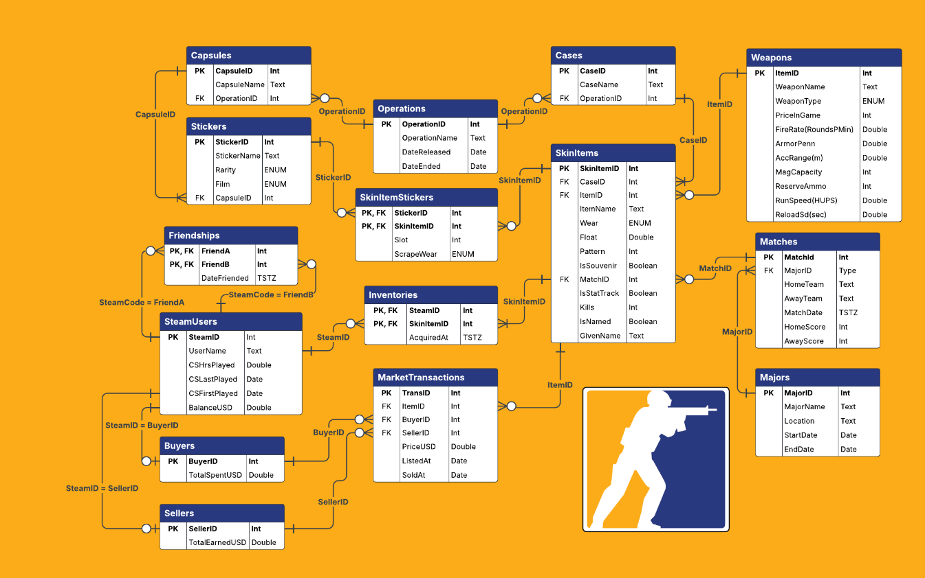
Entity Relationship Diagram
E R D

Slide 5
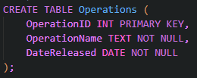
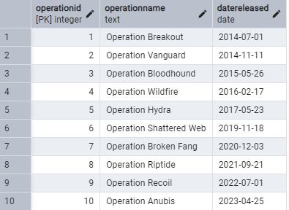
Operations Table
Purpose: Stores information on seasonal operations (in-game events). Create Statement: Functional Dependencies: OperationID → OperationName, DateReleased

Slide 6
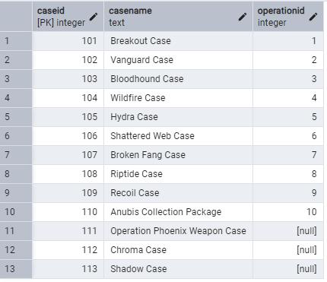
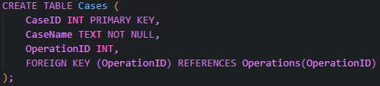
Cases Table
Purpose: Stores information on CS cases (contain items and are opened by users). Create Statement: Functional Dependencies: CaseID → CaseName, OperationID

Slide 7
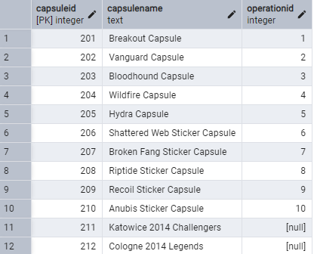
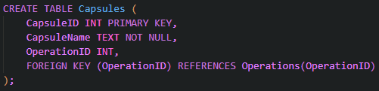
Capsules Table
Purpose: Stores information on CS capsules (contain stickers and are opened by users). Create Statement:
Functional Dependencies: CapsuleID → CapsuleName, OperationID

Slide 8
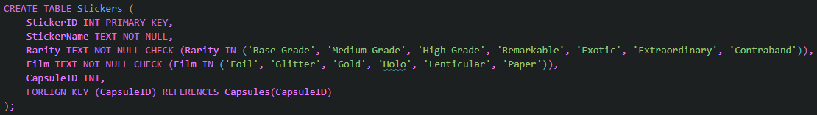
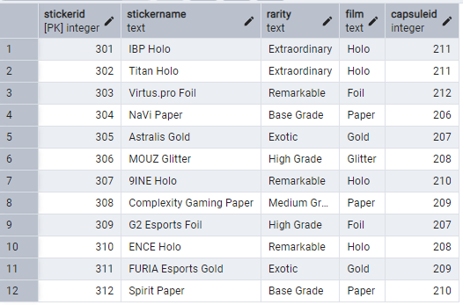
Stickers Table
Purpose: Stores information about CS stickers (obtained from capsules and can be applied to weapon skins). Create Statement: Functional Dependencies: StickerID → StickerName, Rarity, Film, CapsuleID

Slide 9
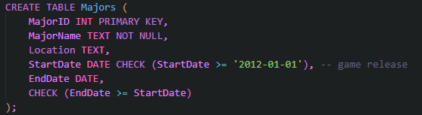
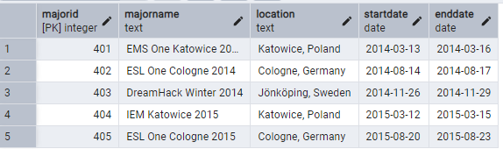
Majors Table
Purpose: Stores information about CS major tournaments. Create Statement:
Functional Dependencies: MajorID → MajorName, Location, StartDate, EndDate

Slide 10
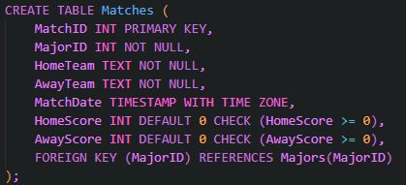
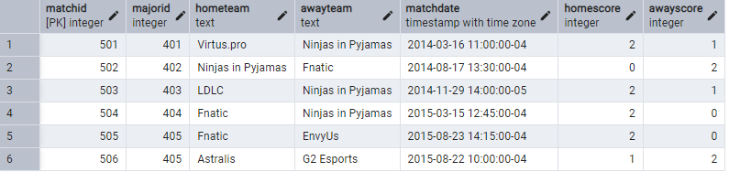
Matches Table
Purpose: Stores information about matches within a major. Items obtained during a match become souvenirs associated with it. Create Statement: AwayTeam, MatchDate, HomeScore, AwayScore
Functional Dependencies: MatchID → MajorID, HomeTeam,

Slide 11
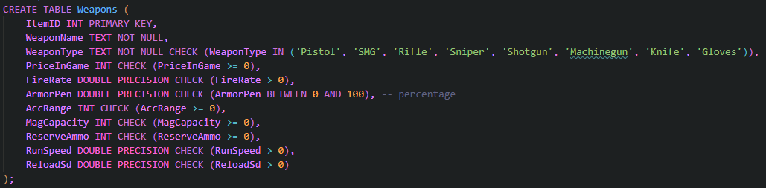
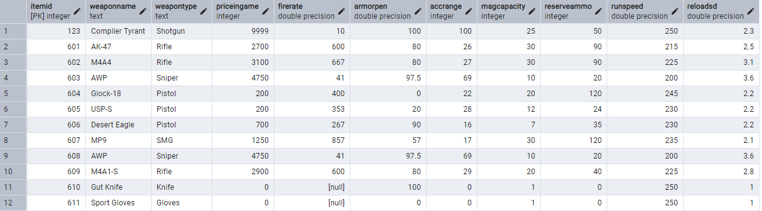
Weapons Table
Purpose: Stores information on the weapons that skins can be obtained for. Create Statement:
Functional Dependencies: ItemID → WeaponName, WeaponType, PriceInGame, FireRate, ArmorPen, AccRange, MagCapacity, ReserveAmmo, RunSpeed, ReloadSd

Slide 12
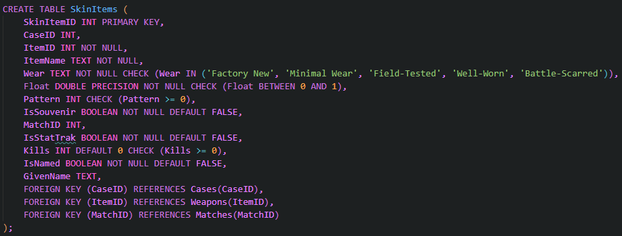
SkinItems Table
Purpose: Stores information about skins for weapons. Create Statement:
Functional Dependencies: SkinItemID → CaseID, ItemID, ItemName, Wear, Float, Pattern, IsSouvenir, MatchID, IsStatTrak, Kills, IsNamed, GivenName

Slide 13
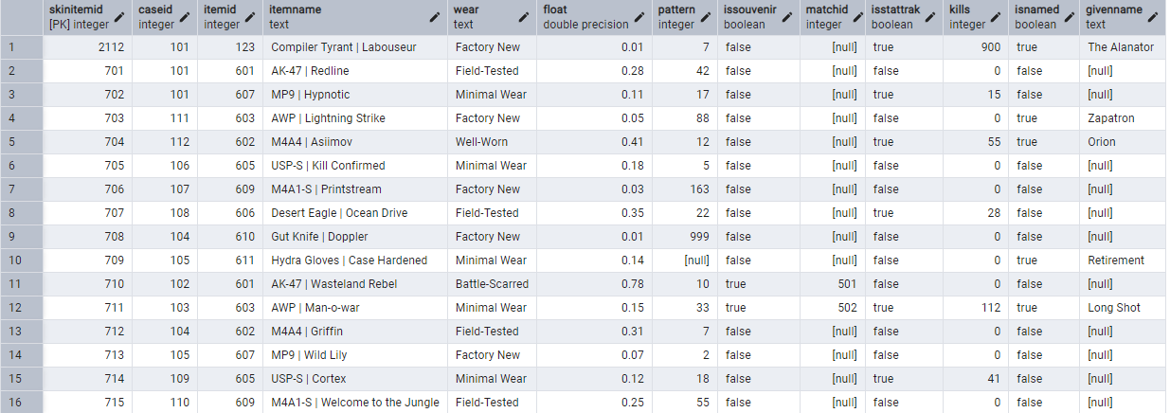
Example SkinItems

Slide 14
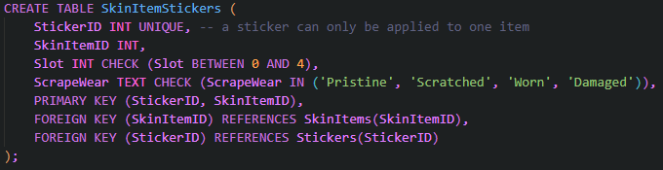
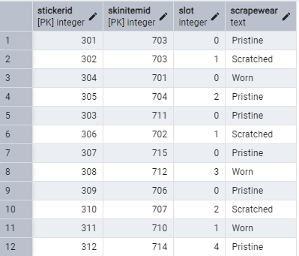
SkinItemStickers Table
Purpose: Stores information about stickers applied to skin items. Create Statement:
Functional Dependencies: StickerID, SkinItemID → Slot, ScrapeWear

Slide 15
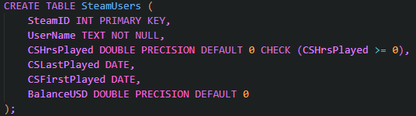
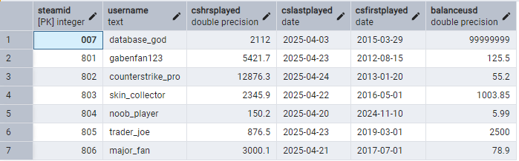
SteamUsers Table
Purpose: Stores information about users that can collect items. Create Statement:
Functional Dependencies: SteamID → UserName, CSHrsPlayed, CSLastPlayed, CSFirstPlayed, BalanceUSD

Slide 16
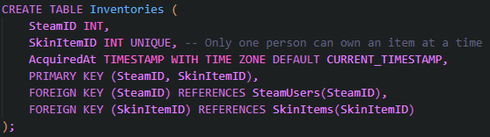
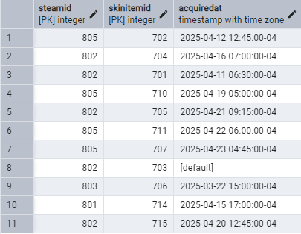
Inventories Table
Purpose: Stores information about what items belong to which users. Create Statement:
Functional Dependencies: SteamID, SkinItemID → AcquiredAt

Slide 17
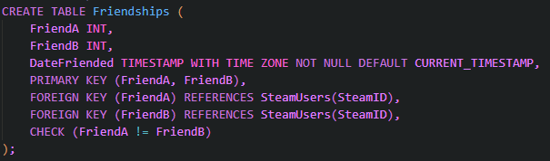
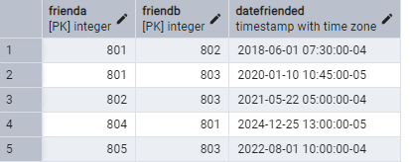
Friendships Table
Purpose: Stores information about user friendships (undirected). Create Statement:
Functional Dependencies: FriendA, FriendB → DateFriended

Slide 18
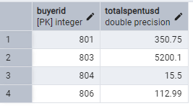
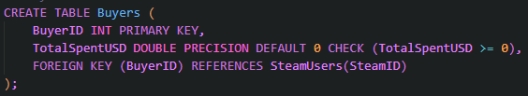
Buyers Table
Purpose: Stores information on users buying items. Create Statement:
Functional Dependencies: BuyerID → TotalSpentUSD

Slide 19
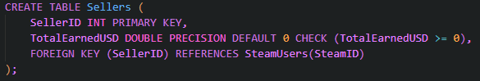
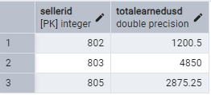
Sellers Table
Purpose: Stores information on users selling items. Create Statement: Functional Dependencies: SellerID → TotalEarnedUSD

Slide 20
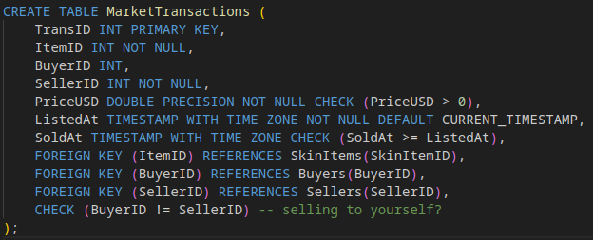
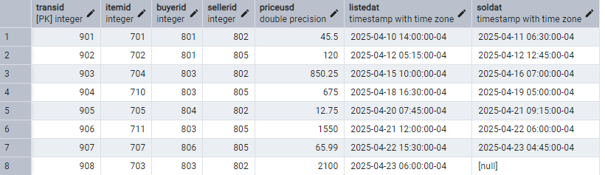
MarketTransactions Table
Purpose: Stores information on item sale transactions.
Functional Dependencies: TransID → ItemID, BuyerID, SellerID, PriceUSD, ListedAt, SoldAt

Slide 21
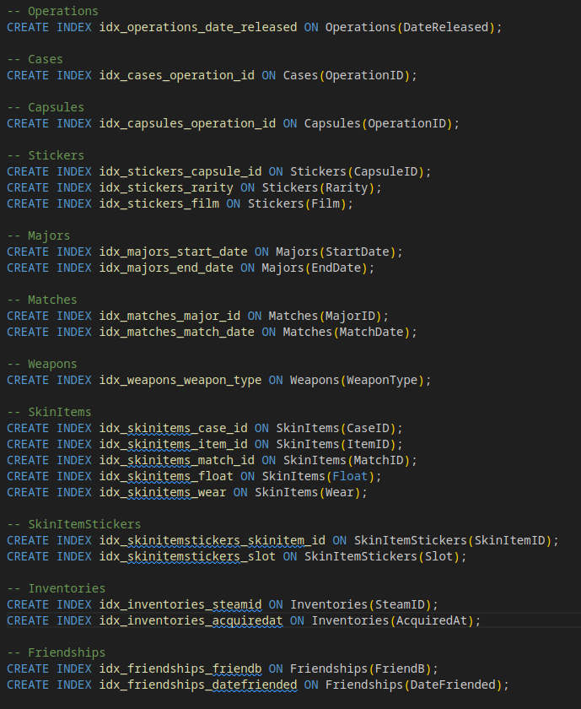
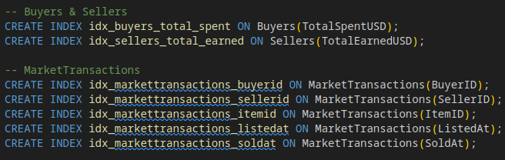
Indexes
A variety of useful indexes are available to speed up data retrieval operations by allowing the database to quickly locate rows matching query conditions, especially on large tables.

Slide 22
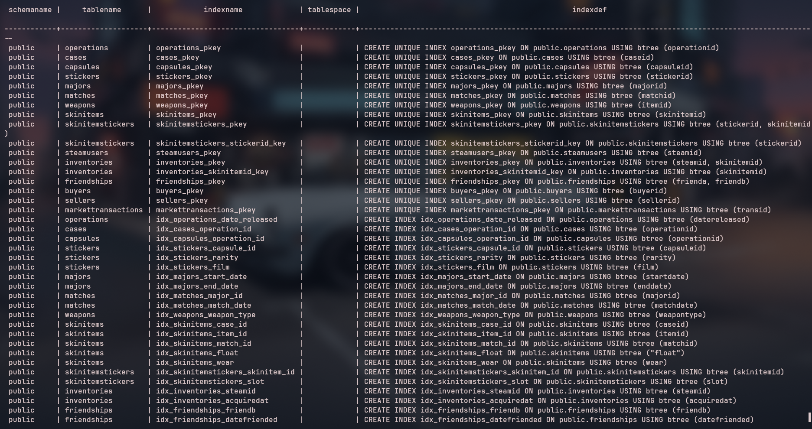
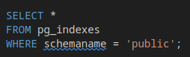

Slide 23
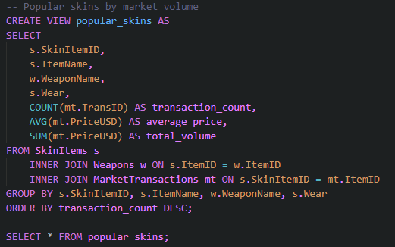
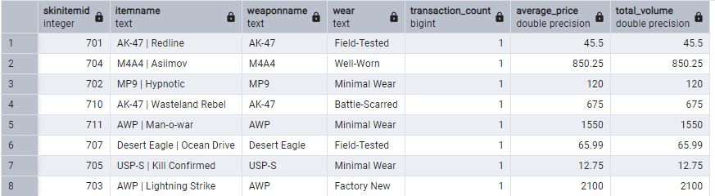
View Report: Popular Skins
Purpose: This view finds the most popular skins being bought and sold on the market.

Slide 24
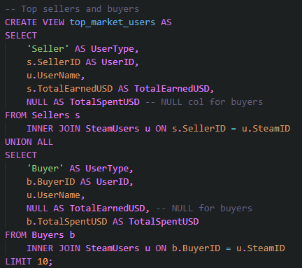
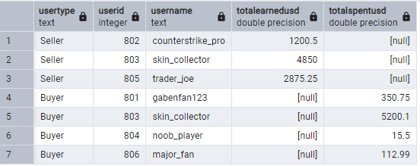
View Report: Top Market Users
Purpose: This view shows the top market buyers and sellers.

Slide 25
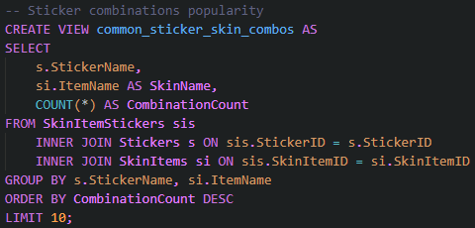
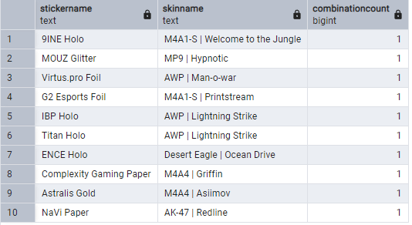
View Report: Common SkinItem Sticker Combos
Purpose: This view shows the user the most common sticker and item skin combinations!

Slide 26
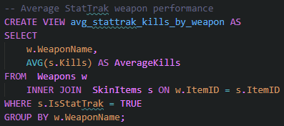
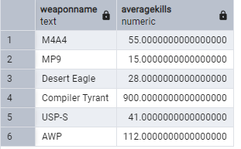
View Report: Average StatTrak Kills By Weapon Type
Purpose: This view details the average amount of StatTrak™ kills for each weapon, regardless of skin.

Slide 27
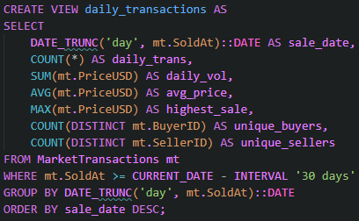
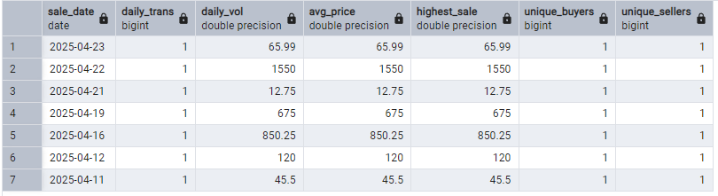
View Report: Daily Transactions
Purpose: This view shows us how strong the item market is each day in the last 30 days.

Slide 28
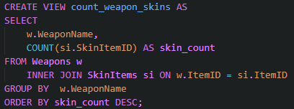
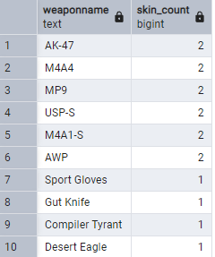
View Report: Top Weapons for Skins
Purpose: This view shows how many skins are available for each weapon.

Slide 29
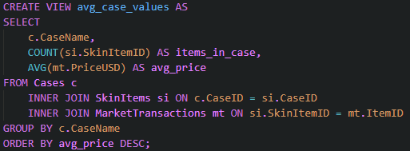
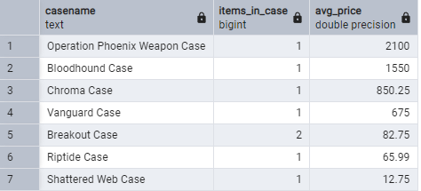
View Report: Average Case Item Values
Purpose: This view shows the average value of items from each case.

Slide 30


View Report: Operation Metrics
Purpose: This view shows the performance metrics for each operation. Metrics include transactions per day, unique skins, market volume, and cases released.

Slide 31


Stored Procedure: Get_User_Items
Purpose: Provided the id of a user, return all of the items in that user’s inventory.

Slide 32


Stored Procedure: Case_Opening_Stats
Purpose: Provided the name of a case, this function determines how often certain drops are obtained.

Slide 33

Stored Procedure: Souvenir_Items_By_Major
Purpose: Provided a major name, this function finds all souvenir items dropped during it, their owners, their values, and more!

Slide 34


Stored Procedure: Get Market Transactions
Purpose: Provided an item name and wear, this function finds all of the market listings and sales of the item.

Slide 35

Trigger: Prevent Duplicate Friendships
Purpose: This function is triggered every time there is an insertion into the friendships table. Since the friendship system is undirected, we do not need a FriendB → FriendA entry if there is already a FriendA → FriendB entry.

Slide 36

Trigger: Confirm Seller Ownership
Purpose: This function is triggered when a seller lists an item and ensures that the item is actually in the seller’s inventory.

Slide 37




Trigger: Transfer Item Ownership
←Before | After→
Purpose: This function is triggered when a transaction is inserted or updated. It transfers the ownership of an item from the seller’s inventory to the buyer’s inventory on transaction completion.

Slide 38




Trigger:
Transfer Funds
Purpose: This function runs when a transaction is inserted or updated and ensures that the buyer has enough balance to purchase the item. It then transfers the funds properly as well as updates buyer totalSpent and seller totalEarned!
←Before | After→

Slide 39

Security
Groups: Admins
Application Analysts
Details The security of this database has admin users, an application service user, and an analyst user.
The admin has full access to the entire database and schema.
The application service account can read and write data, but not alter the schema.
The analysts can only read data and utilize stored procedures.
Connections are limited for security.

Slide 40
Implementation Notes
Friendships are undirected. Operations are in-game events that contain cases, capsules, etc. Not all cases and capsules need to be part of an operation.
Items obtained from a case during a major match will become a souvenir item. There is a steam fee whenever an item is sold. Items can be named by players. Items can be StatTrak™, meaning that the kills achieved with the weapon are counted. Items have varying levels of wear on them, indicating damage to the item. The float is simply a more precise description of this wear as opposed to the wear name. The same skin for the same item may also come in several patterns. Stickers can be scraped off of items to varying degrees. A sticker’s ‘Film’ refers to its finish, for example, a metallic foil. Stickers can be applied to items at preset locations, known as slots. Some items have more slots than others.

Slide 41
Known Problems
This database has a small set of known flaws: The ‘Location’ field of the Majors table can be further broken down for normalization purposes. The MarketTransactions Table may not scale well to a busy market system. User inventories cannot hold stickers, so it is unclear how users could obtain them or apply them to their items.
The SkinItemStickers table does not prevent the same item from having over 4 stickers applied to it. It is also possible to apply multiple stickers in the same slot. Both of these scenarios are erroneous. Triggers would fix these issues.

Slide 42
Future Enhancements
There are several features in the real CounterStrike item & market system that could be added to this database implementation.
Some sticker capsules are associated with majors similar to souvenir skins. This functionality could be added with a foreign key to the majors table. A user’s inventory can contain more than just weapon skins. It can also hold stickers, capsules, cases, case keys, name tags, sprays, music kits, etc! Item trades between users can be implemented.
Users can place ‘buy orders’ to buy a specific quantity of a specific item at a specific price.

Slide 43
CounterStike
Thank You

